Slide 1
Energy production prediction of ccpp
Mentor: Varun sir
Group No. 6
Arijit Sarkar
Nikhil Rajurkar
Gowtham M

Slide 2

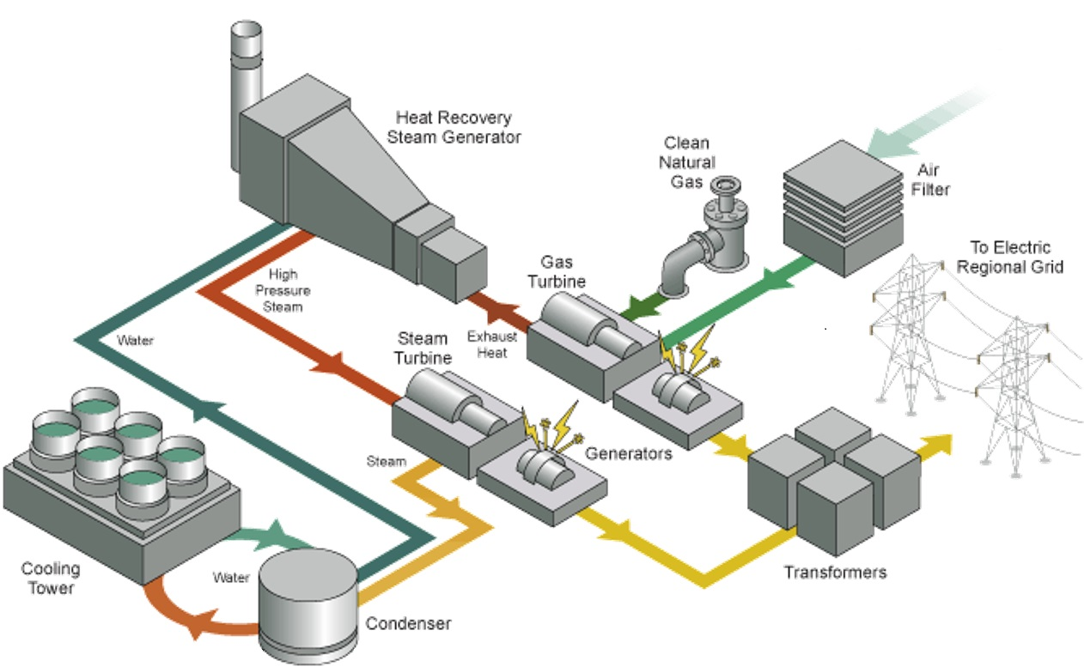
Working of combined cycle power plant

Slide 3
Business objective
Create a Data Model to Predict the Net Hourly Electrical Energy Output ( EP ) of the Plant using the Following Hourly Average Ambient Variables:
Temperature ( AT )
Exhaust Vacuum ( EV )
Ambient Pressure ( AP )
Relative Humidity ( RH )
Identify the Relationship between the Response Variables and Predictor Variable.
Identify the Impact of Vacuum on Power Compared to Other Variables ( Vacuum is Generated and Collected from the Steam Turbine )

Slide 4
Introduction
What is Combined Cycle Power Plant (CCPP) ?
A Combined Cycle Power Plant, is an Electrical Power Plant in which a Gas Turbine (GT) and a Steam Turbine (ST) are used in Combination to Produce More Electrical Energy from the Same Fuel than would be Possible From a Single Cycle Power Plant.
The Gas Turbine Compresses Air and Mixes it with a Fuel Heated to a very High Temperature. The Hot Air-Fuel Mixture Moves through the Blades making them Spin. The Fast Spinning Gas Turbine Drives a Generator to Generate Electricity.
The Exhaust ( Waste ) Heat Escaped through the Exhaust Stack of the Gas Turbine is Utilized by a Heat Recovery Steam Generator (HSRG) System to Produce Steam that Spins a Steam Turbine. This Steam Turbine Drives a Generator to Produce Additional Electricity.
CCPP is assumed to Produce 50% More Energy than a Single Power Plant.

Slide 5
Project flow
Preparing the Data
Exploratory Data Analysis
Model Building
Evaluation
Model Deployment

Slide 6
DATA PREPARATION
The Dataset Contains Four Independent Variables and One Dependent Variable.
Dependent Variable ( Predictor Variable ) : Electrical Energy Output ( Energy )
Independent Variables ( Response Variables )
Temperature ( AT )
Exhaust Vacuum ( EV )
Ambient Pressure ( AP )
Relative Humidity ( RH )
The Dataset Contains 9568 records each with Measurements for the Four Ambient Variables and the Electricity Generated Hourly.
The Dataset Contains Few Outliers .However the Presence of Outliers has been Found not affecting the Mean. Hence the Outliers have been retained.

Slide 7
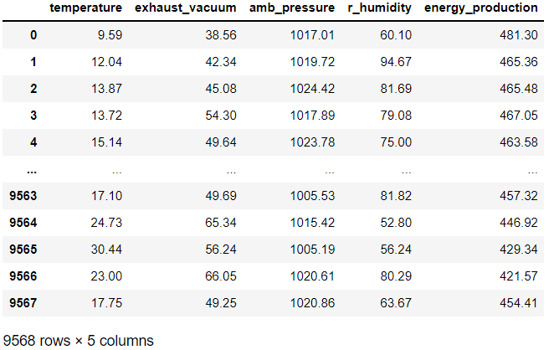
Dataset details
Dataset contains 9568 rows and 5 columns.

Slide 8
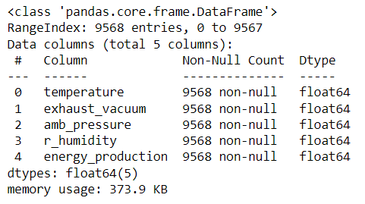
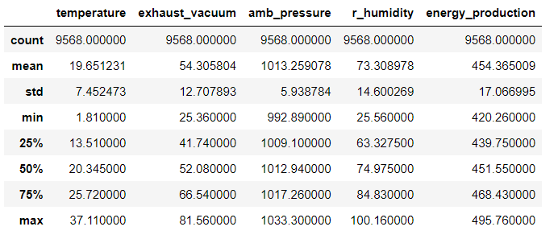
Other basic info of data
None of the column have null-values.
All the values in the dataset are of Float64 type.

Slide 9
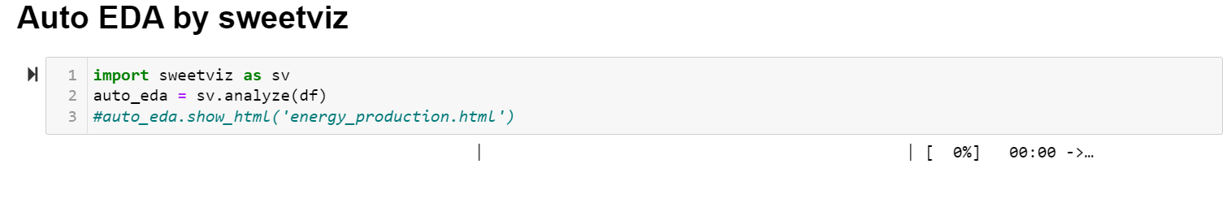
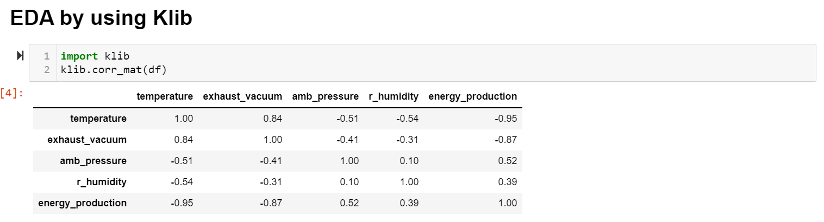
EXPLORATORY DATA ANALYSIS
Auto EDA by SWEETVIZ.
EDA by using KLIB.

Slide 10
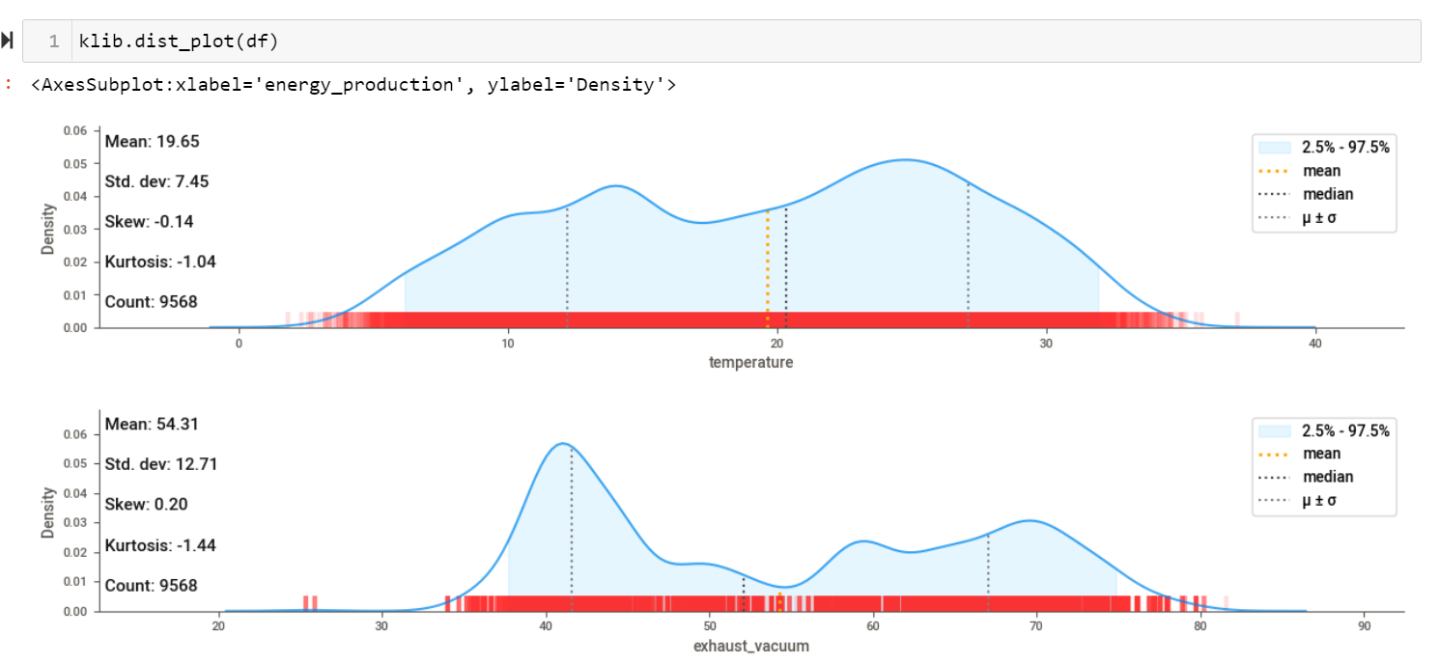
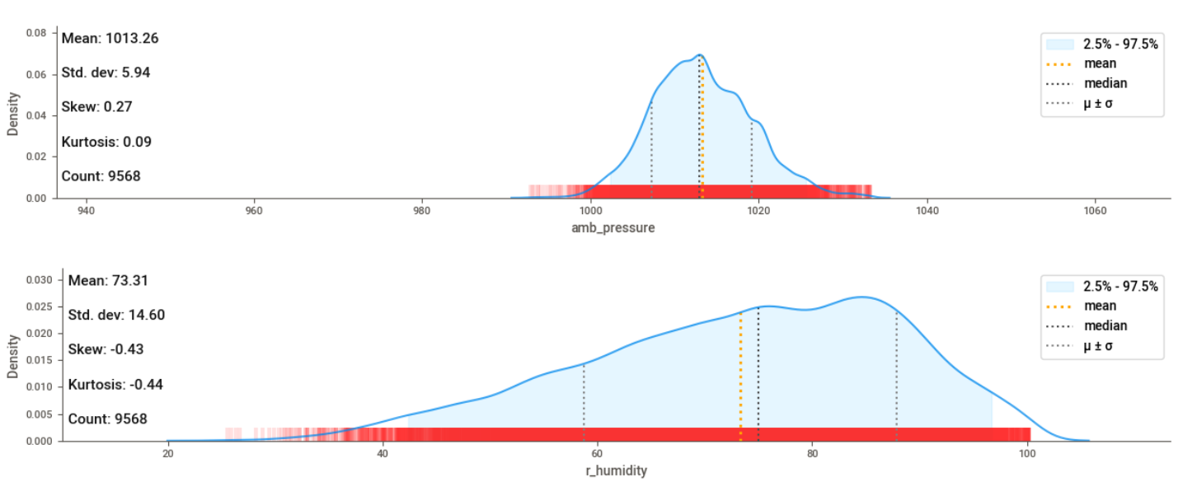
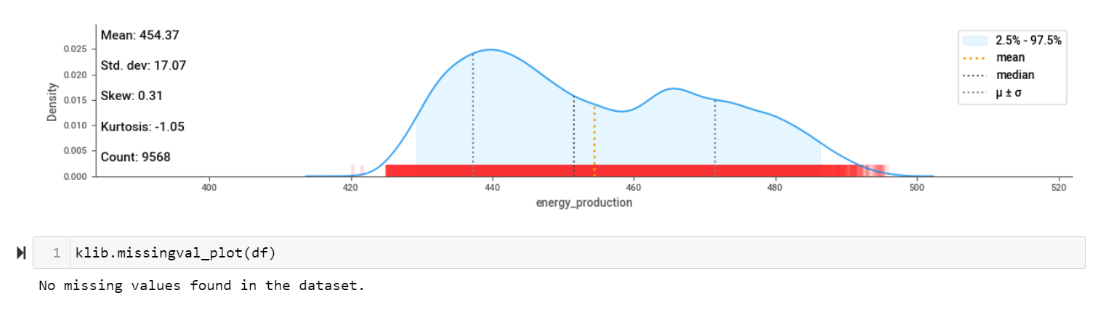
EDA BY USING KLIB

Slide 11
Other basic info of data
None of the column have null-values.
All the values in the dataset are of Float64 type.

Slide 12
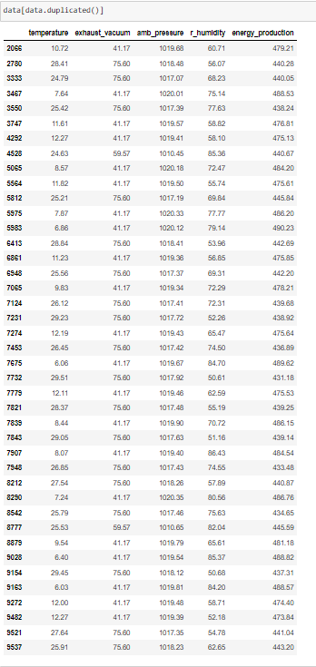

Duplicate values
There are a total of 41 duplicate values in the dataset.
Duplicate values:

Slide 13
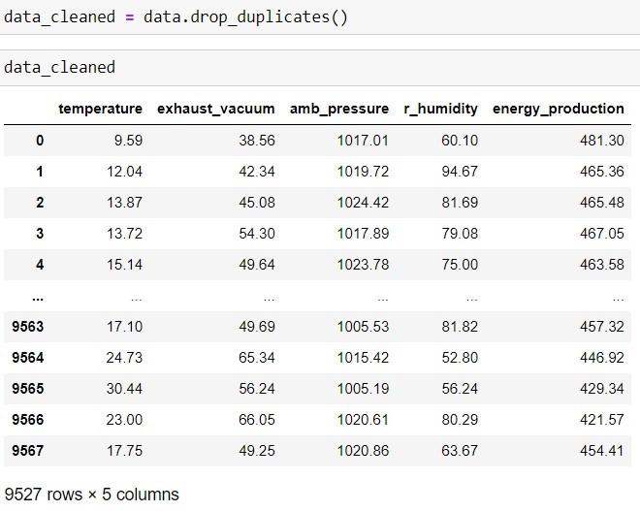
Cleaning duplicate values
After cleaning all the duplicate values, the dataset contains 9627 rows.

Slide 14
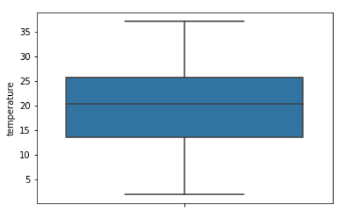
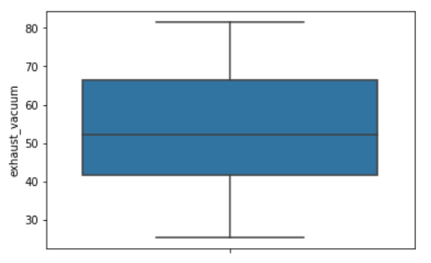
Finding outliers
Temperature and Exhaust vacuum columns doesn’t have any outliers

Slide 15
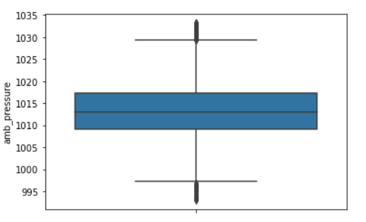
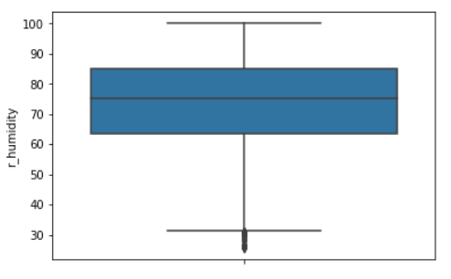
Finding outliers
Ambient pressure and Relative humidity contains outliers.

Slide 16
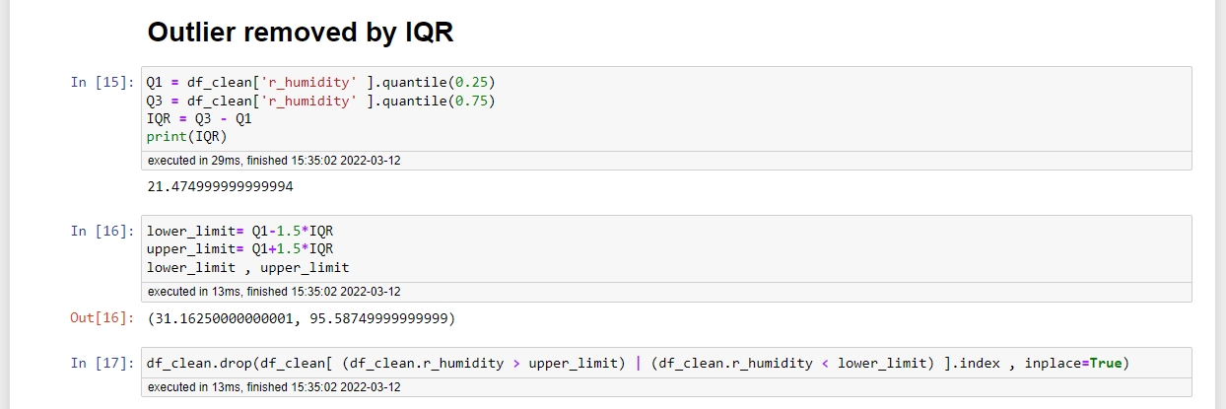
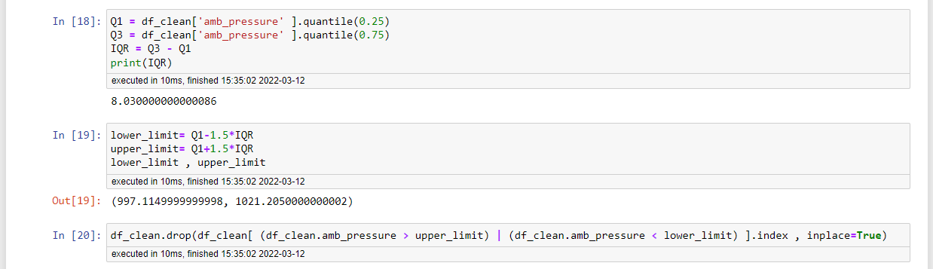
Removing outliers

Slide 17
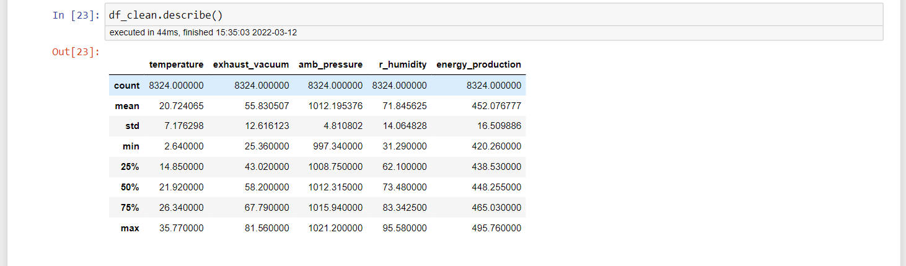
Final “dataset”
After performing all data cleaning techniques –
No null values are present,
Removing 41 duplicate values, and
Removing outlier…
The dataset contains 8324 rows

Slide 18
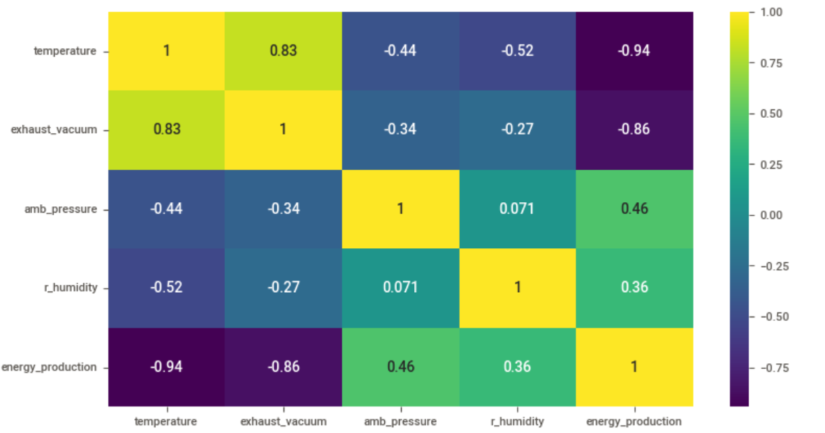
DISTRIBUTION OF ENERGY PRODUCTION
From the Correlation Heatmap because of High Positive Correlation between Temperature and Exhaust Vacuum ( 0.83 ) there is chance of Multicollinearity for that We checked P_values.

Slide 19
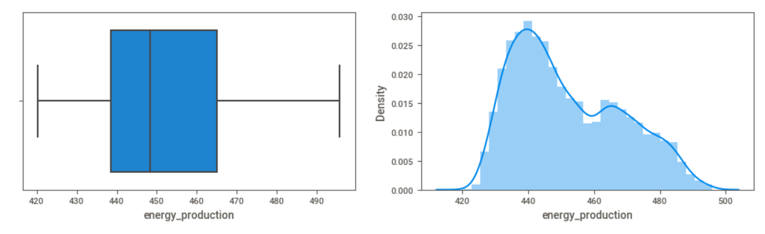
CORRELATION
After Performing all the Necessary of Data Cleaning Techniques are No Null Values are Present, Removing of Duplicates Values and Removing of Outlier. The Dataset contains 8324 records is Found and Distribution of Energy Production.

Slide 20
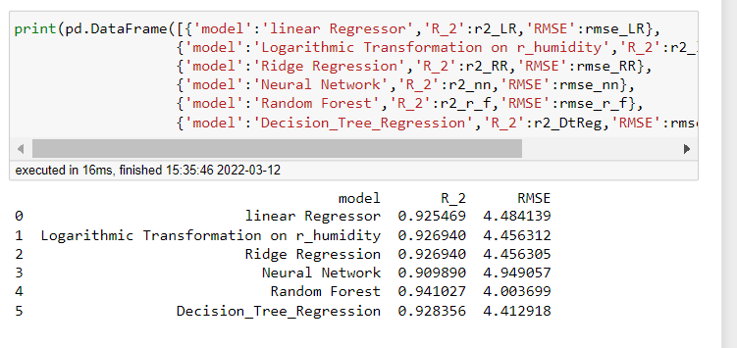
comparing ALL MODEL RESULTS

Slide 21
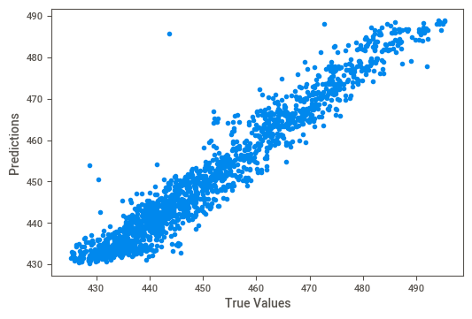
True vs Predicted data
Random forest regression

Slide 22
By comparing all model results it is seen that the Random Forests model is best model
This time a multivariable linear regression model was fit that included all 4 features and a 70-30 % split to see how this
affects output. We got the following result:
R2 Score: 0.9291122029295451
Mean Absolute Error: 3.6035800582771387
Mean Squared Error: 20.552286757899513
Root Mean Squared Error: 4.533462998404146

Slide 23
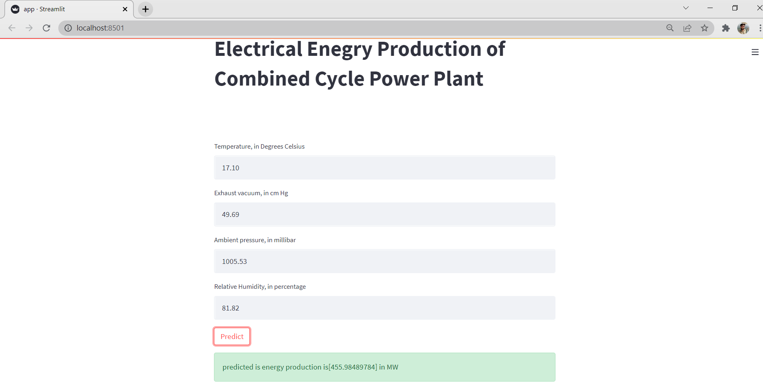
Deployment using streamlit

Slide 24
Thank you

